Slide 1
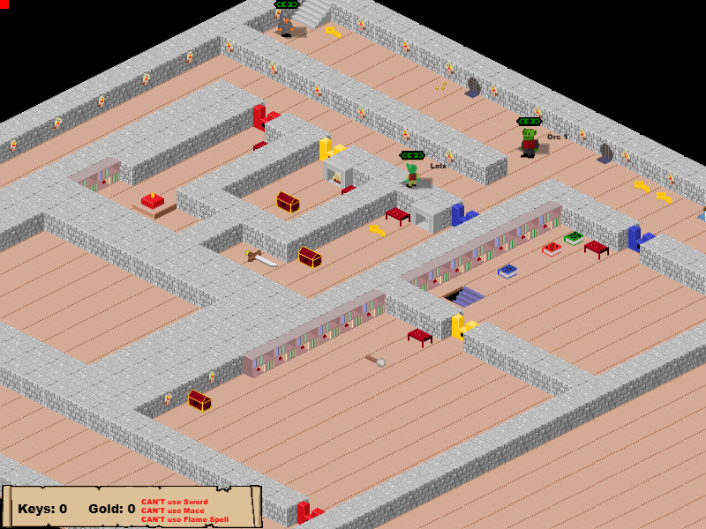
Descend Below the Crypts
Week 2
Pitch Date: October 20 , 2019
Release Date: February 9, 2020
Team Lead: Vince McKeown
November 3, 2019

Slide 2






Artwork

Slide 3
Code
Player can select which character
Refactored character selection page (with help from Chris)
Connected Jaime’s background music
WIP: Pathfinding
Added Debug State

